Slide 1
NBD1100 Built Environment Communication and Skills

Slide 2
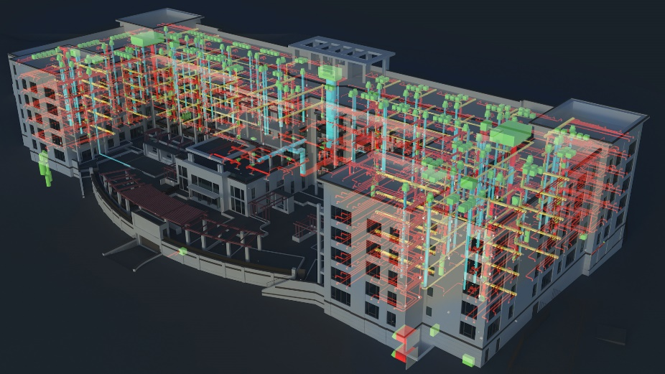
Why do clashes occur?
Architecture
Construction
Mechanical
Electrical Plumbing

Slide 3
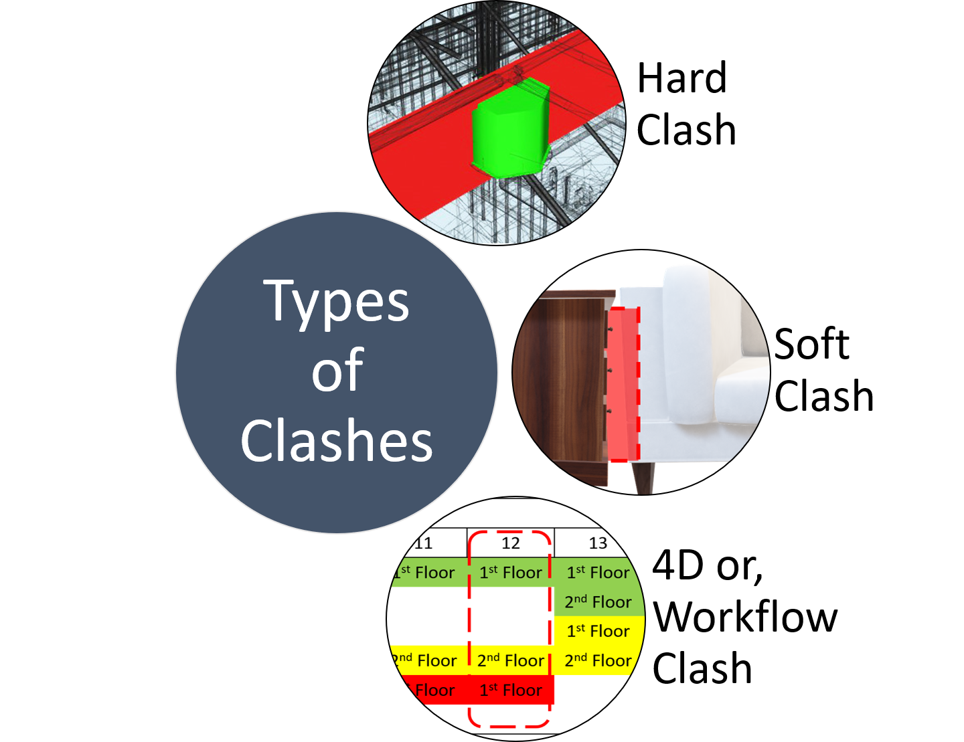
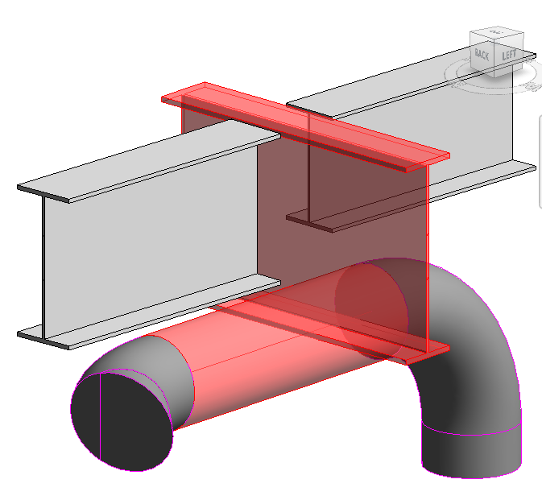
Types of clashes
Hard clash
Soft clash
Workflow or 4D clash

Slide 4
Types of clashes
Hard clash – where two components are occupying the same space, such as a pipe running through a steel beam. If this kind of clash isn’t detected until on site, then it can be costly and time-consuming to correct.
Soft clash – when the buffer zone of an element is breached, or it isn’t given the spatial tolerances it requires for maintenance access or safety.
Workflow or 4D clash – general time conflicts such as the delivery of equipment and materials, or the scheduling of contractors.

Slide 5
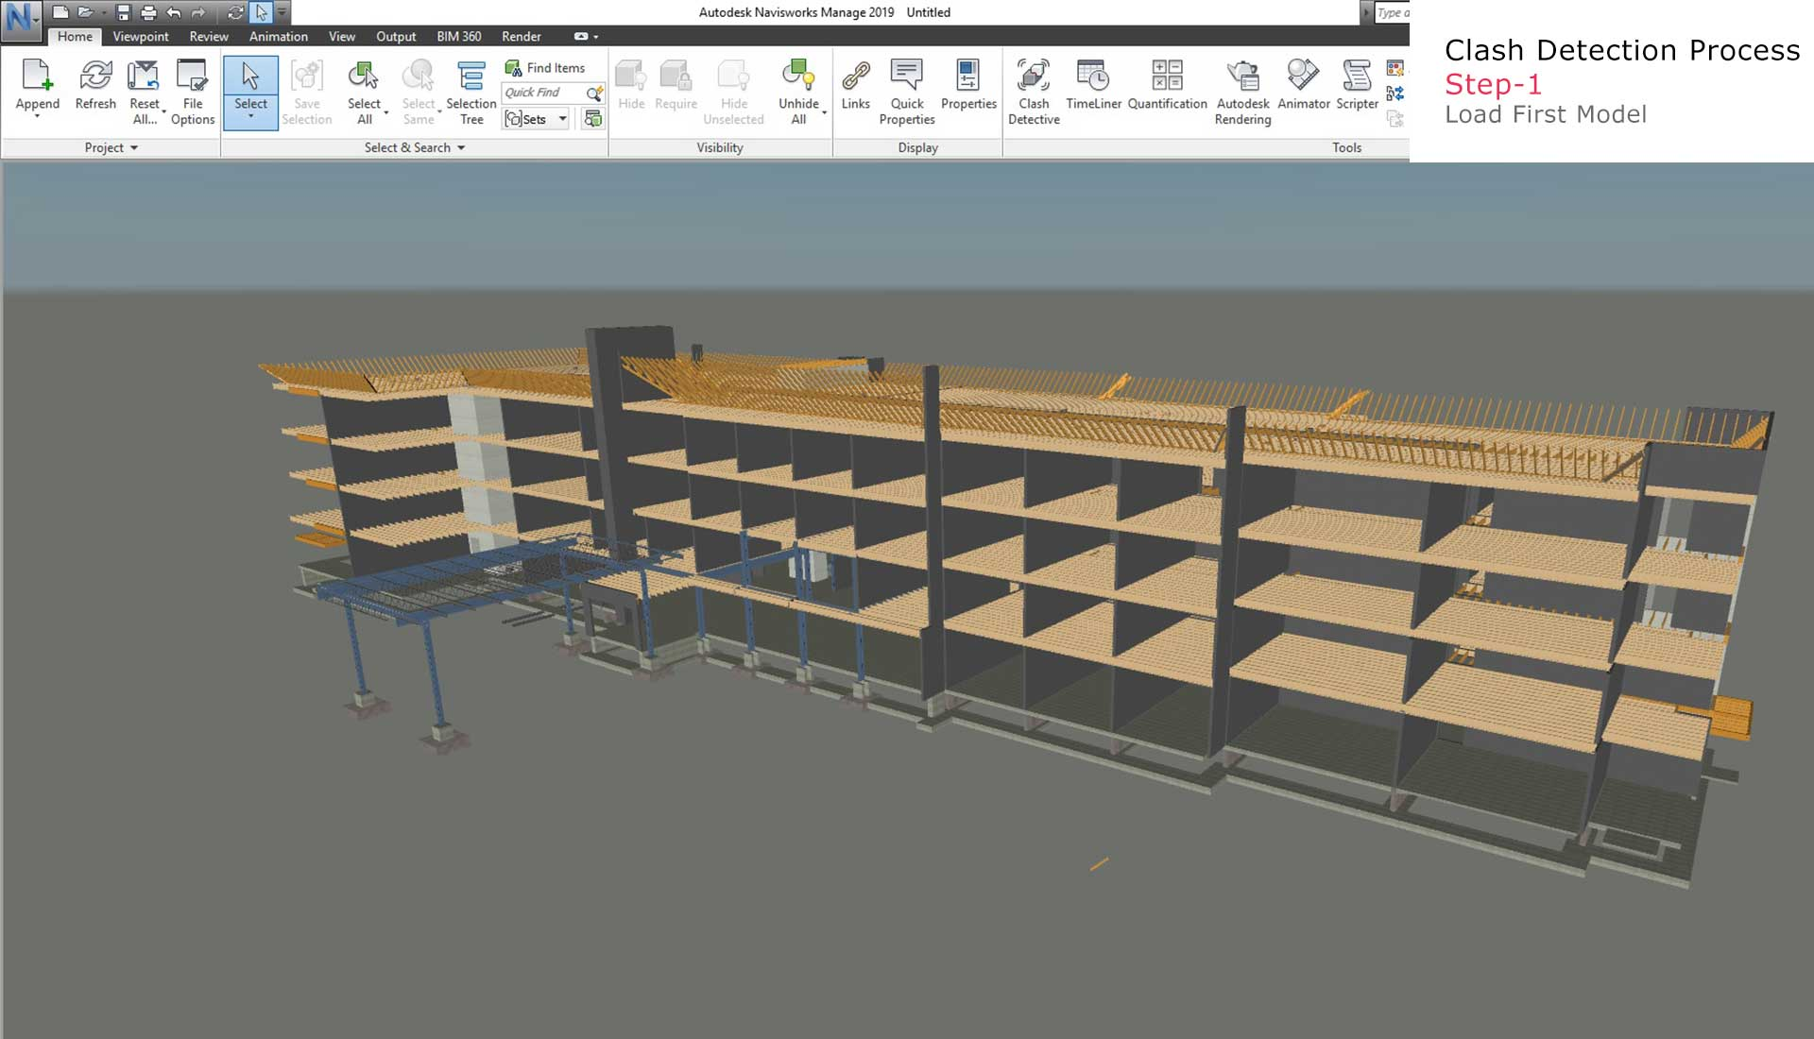
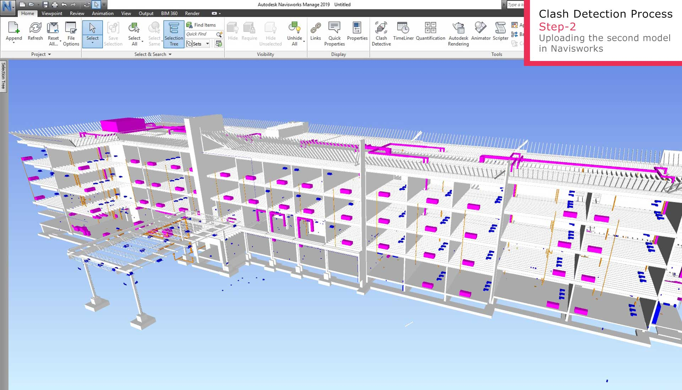
Need to analyse between two models
Load the second model and merge the two models

Slide 6
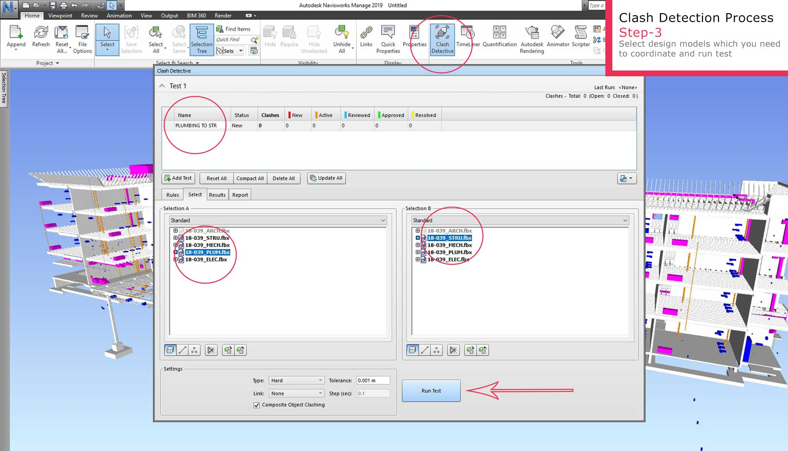
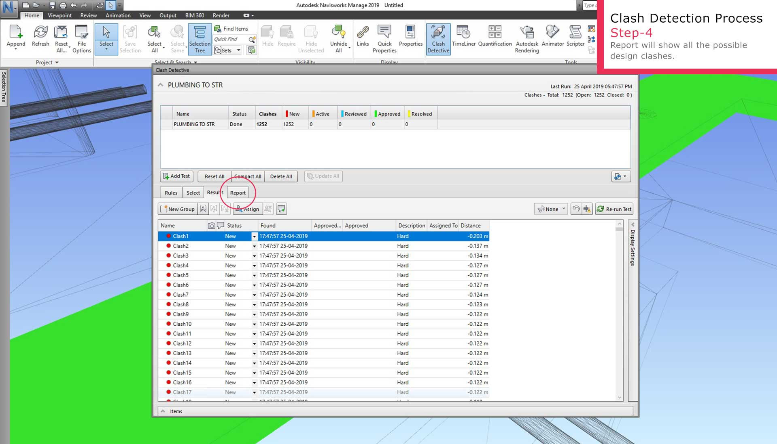
Clash detection
Load the second model and merge the two models

Slide 7
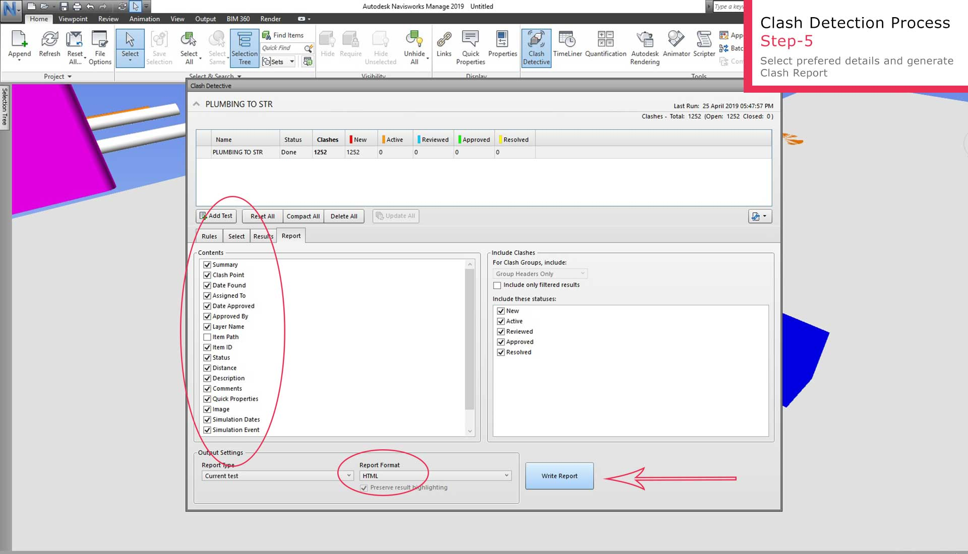
Generate clash a report

Slide 8
NBD1100 Built Environment Communication and Skills

Slide 9
Why do clashes occur?
Architecture
Construction
Mechanical
Electrical Plumbing
Notes:
As we have mentioned, a range of services have to come together in order for the end building to appear. The Architect will produce a model, and then the structural engineer, mechanical and electrical engineer and the environmental engineer will all produce their own models based on that. Each of these models may contain documents, structured data files and other files which can contain non-geometric data about what is being built. These models are all then brought together into a digital model which will initially show what has been designed, and by the end of the project will show what has been built and installed.
MEP (Mechanical, electrical, and plumbing)

Slide 10
Types of clashes
Hard clash
Soft clash
Workflow or 4D clash
Notes:
Hard clash – where two components are occupying the same space, such as a pipe running through a steel beam. If this kind of clash isn’t detected until on site, then it can be costly and time-consuming to correct.
Soft clash – when the buffer zone of an element is breached, or it isn’t given the spatial tolerances it requires for maintenance access or safety.
A 'soft clash' occurs when an element isn't given the spatial or geometric tolerances it requires or its buffer zone is breached. For example, an air conditioning unit may require certain clearances to allow for maintenance, access or safety that a steel beam would negate.
Workflow or 4D clash – general time conflicts such as the delivery of equipment and materials, or the scheduling of contractors.
Workflow clash detection (or 4D clash detection) identifies conflicts in equipment, material delivery, scheduling, and other timelines. Sequenced timelines can be developed by inputting the start and end times of each activity.

Slide 11
Types of clashes
Hard clash – where two components are occupying the same space, such as a pipe running through a steel beam. If this kind of clash isn’t detected until on site, then it can be costly and time-consuming to correct.
Soft clash – when the buffer zone of an element is breached, or it isn’t given the spatial tolerances it requires for maintenance access or safety.
Workflow or 4D clash – general time conflicts such as the delivery of equipment and materials, or the scheduling of contractors.
Notes:
Hard clash – where two components are occupying the same space, such as a pipe running through a steel beam. If this kind of clash isn’t detected until on site, then it can be costly and time-consuming to correct.
Soft clash – when the buffer zone of an element is breached, or it isn’t given the spatial tolerances it requires for maintenance access or safety.
Workflow or 4D clash – general time conflicts such as the delivery of equipment and materials, or the scheduling of contractors.

Slide 12
Need to analyse between two models
Load the second model and merge the two models
Notes:
https://www.united-bim.com/what-is-clash-detection-in-bim-process-benefits-and-future-scope-in-modern-day-aec-industry/
Clash report is always generated between two design models (using AutoDesk’s Navisworks). The first step involved uploading the existing design model of one discipline into (the Navisworks) software. We can choose any two models to generate possible clashes between them in the coordinated model.
In the second step, we need to load the second design model which we need to coordinate with the first independent model. These two separate models are merged in a single model for the further clash detection process.

Slide 13
Clash detection
Load the second model and merge the two models
Notes:
Next steps involve starting the clash detection process through choosing these two models from the loaded models. Naming this report and running the clash test.
After running the scan, the system gives us all the potential clash between those models with status details, description and condition according to their level. It provides its status as new, active, approved and resolved which is essential when re-running the test after design alteration.

Slide 14
Generate clash a report
Notes:
At the last stage of this process, it allows us to select all the details we want to include in the Clash Report. We can choose from the available options for the format of the report, (i.e. HTML, PDF, etc). Once we generate the clash report by clicking on the “Write Report”, it generates a detailed report and individual images showing those clashes in two designs.

